Slide 1
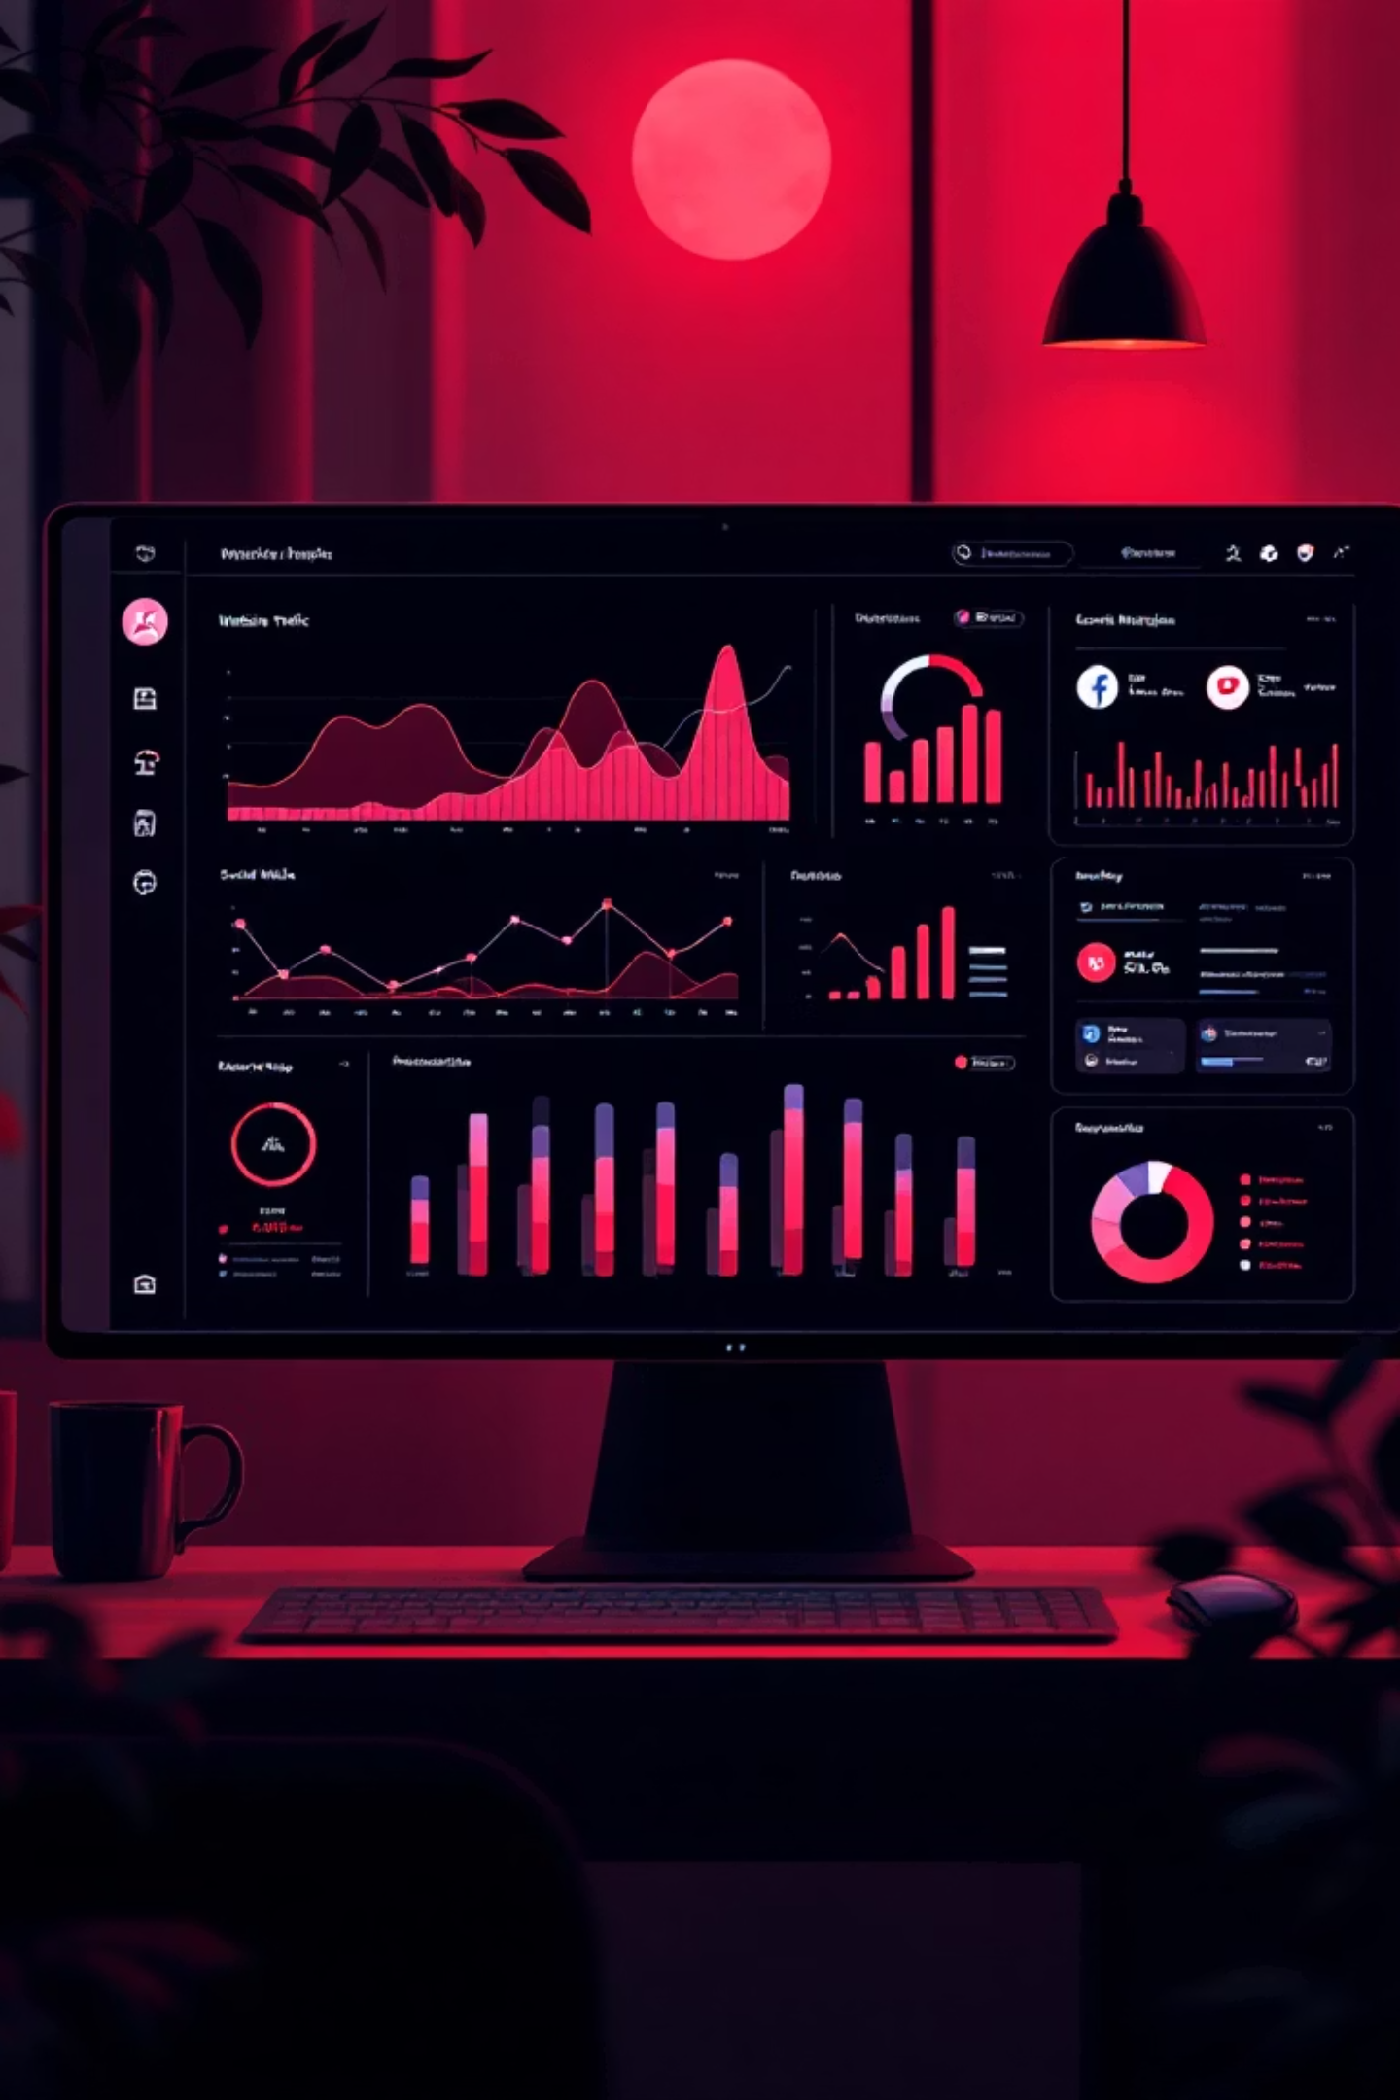
Digital Marketing Campaign Performance Report
A comprehensive analysis of campaign performance, audience insights, and strategic recommendations for optimization.

Slide 2
Executive Summary
Controlled Spending
Positive ROI
Campaign remained within budget with strong traffic generation and moderate conversions.
1.98% ROI indicates profitability, though room exists for aggressive growth.
Star Performer
Critical Issue
Age 30–34 segment delivered highest conversions, revenue, and engagement.
CTR of 0.01 signals weak ad engagement requiring immediate creative refresh.

Slide 3

Key Performance Metrics
Total Spend
19,620
Within budget; no overspending
Total Clicks
11,674
Conversions
Strong traffic flow
585
Medium performance; can improve
CTR
0.01
CPC
Very low → creatives/targeting need work
1.68
Efficient cost per click
ROI
1.98%
Positive ROI; campaign is profitable

Slide 4
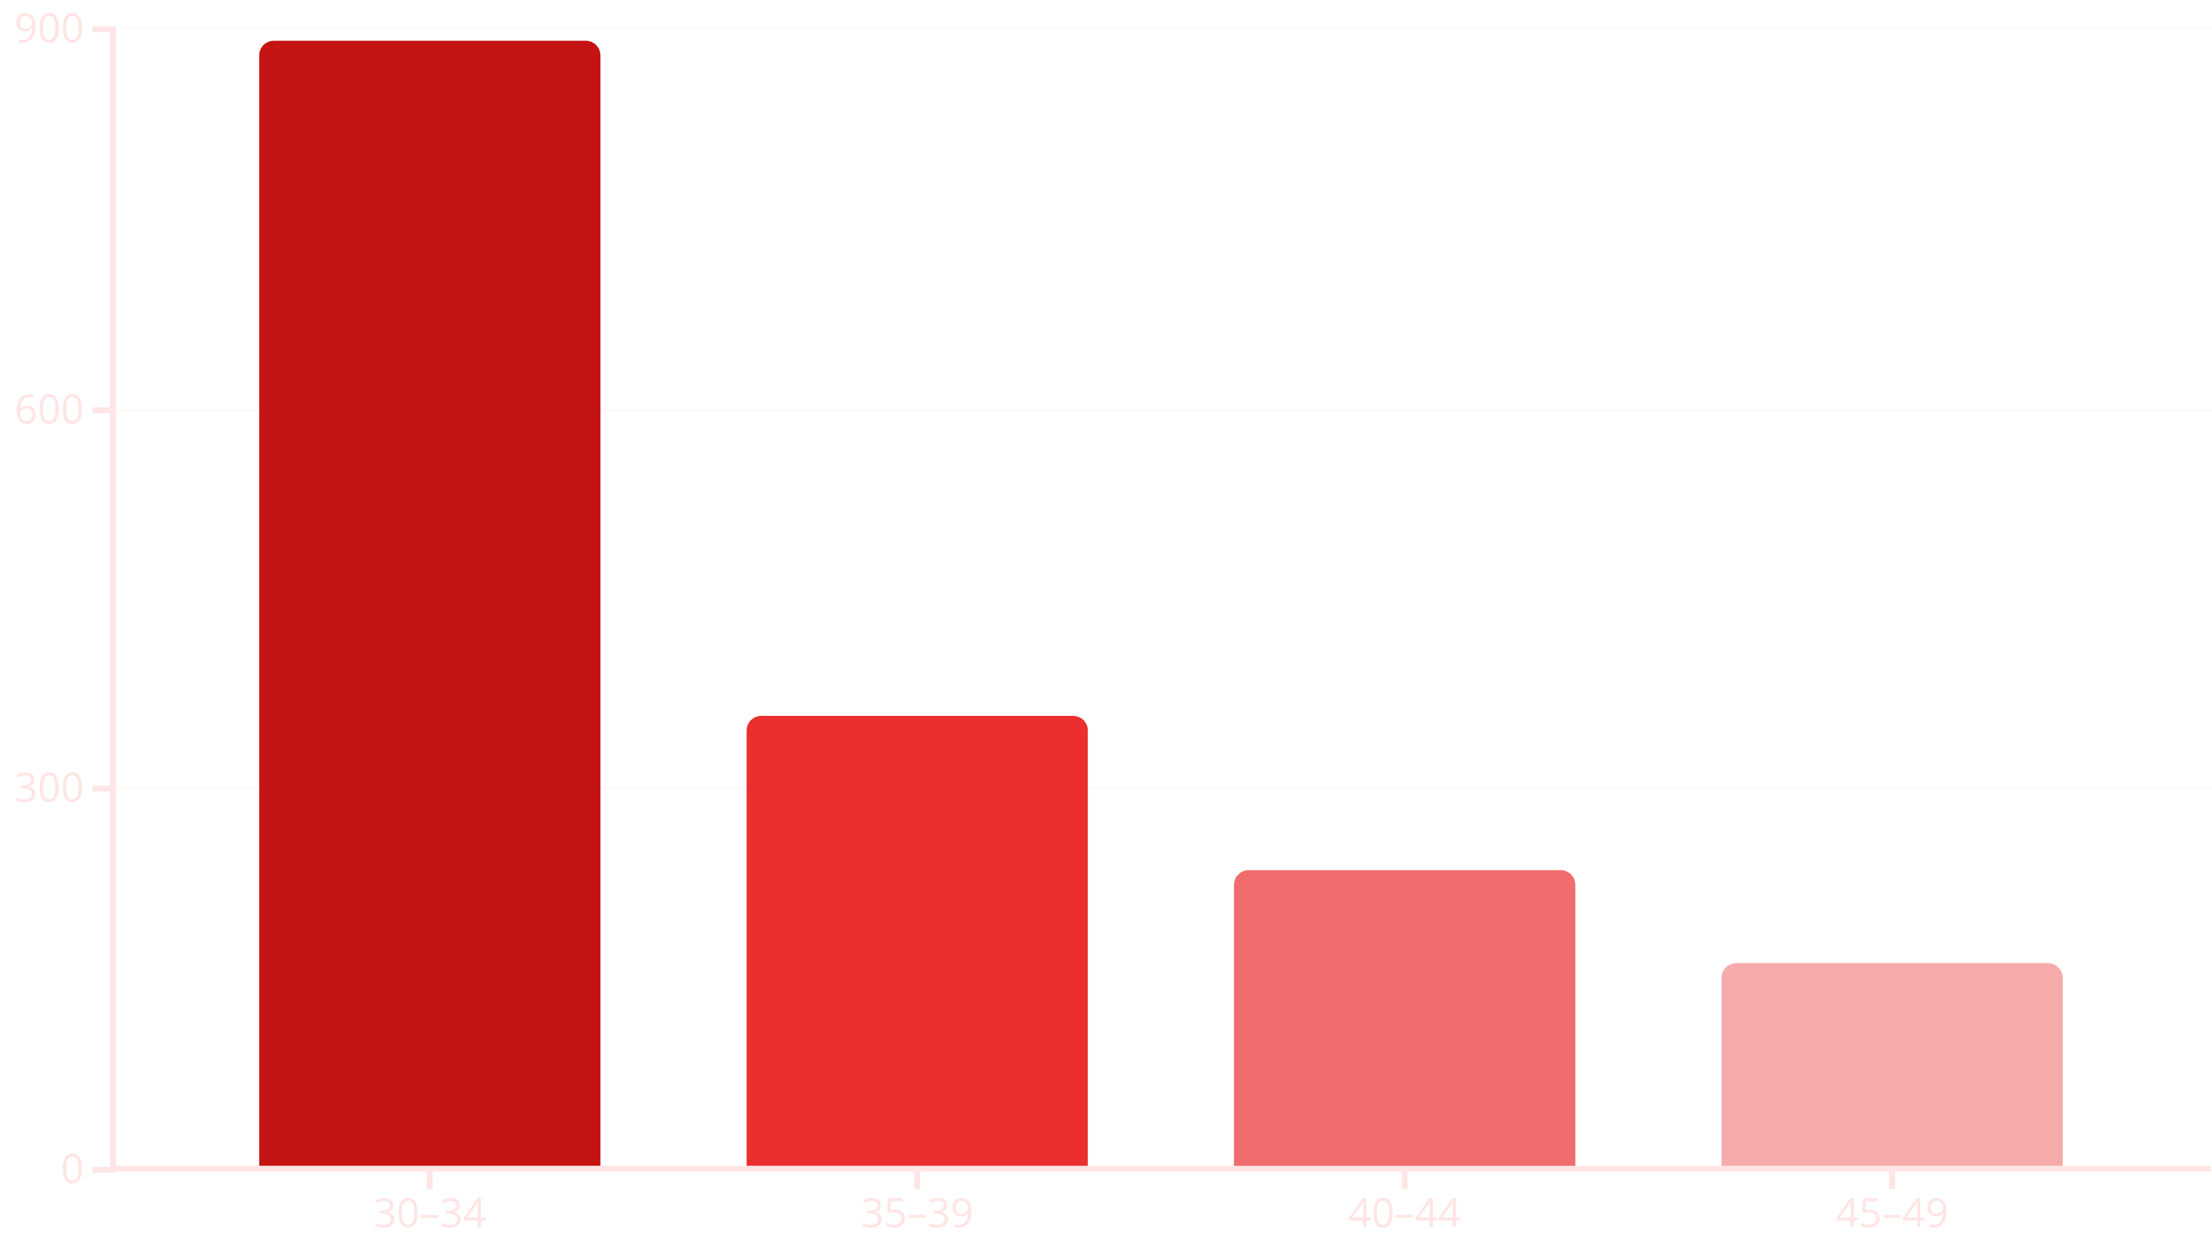
Age-Based Performance Insights
The 30–34 age group shows the strongest intent to take action, converting at nearly 2.5x the rate of the next closest segment.

Slide 5





Revenue Distribution by Age
56%
22%
Age 30–34
Age 35–39
₹33,000+ revenue — over half of total
₹13,000 revenue contribution
14%
8%
Age 40–44
Age 45–49
₹8,000 revenue generated
₹5,000 revenue — lowest performer
Total Revenue: ₹59,000 — The 30–34 segment alone contributed over 50% of all revenue, making it the clear priority for future investment.

Slide 6
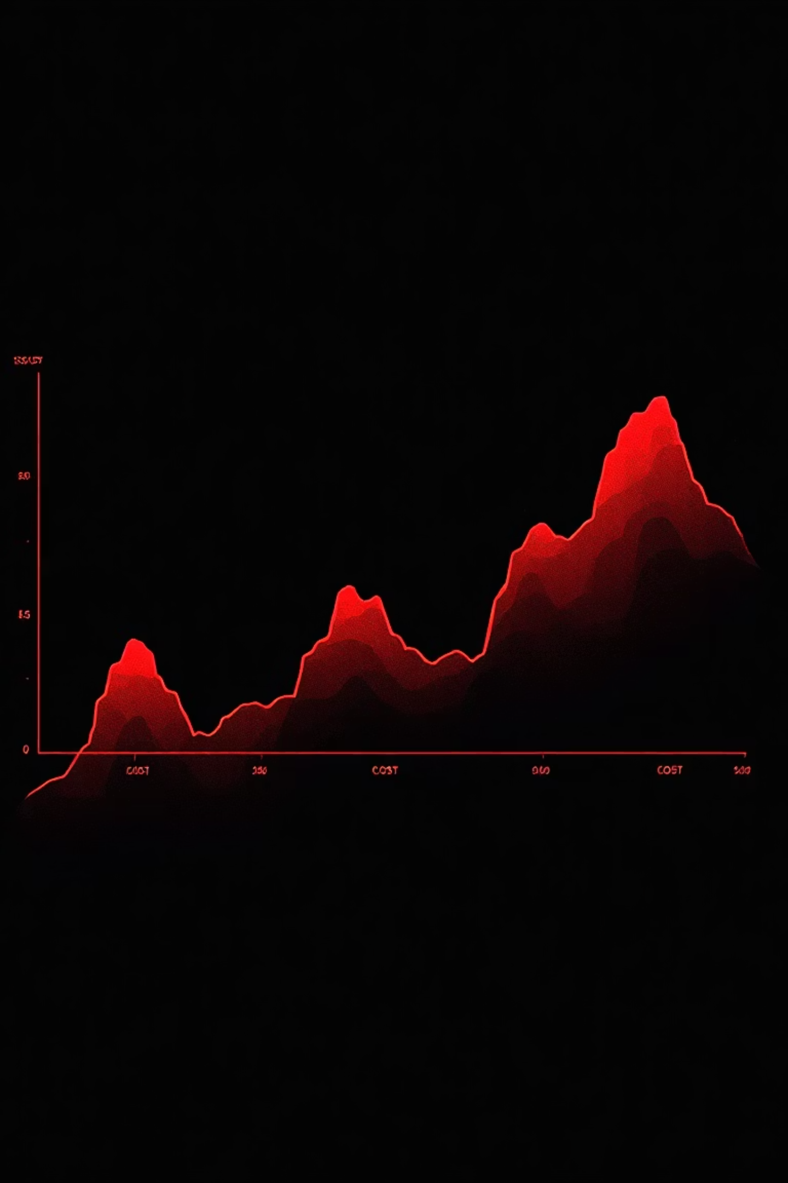
Cost vs Conversion Trend
Early Months
Later Months
High cost with low conversion indicated inefficiency in spending and targeting.
Cost decreased while conversions stabilized, showing successful optimization efforts.
The trend reveals that consistent audience targeting improves performance, while aggressive spending doesn't always drive more conversions.

Slide 7

Channel Performance Analysis
Clicks by Channel
Impressions by Channel
Most clicks from Organic Search and Paid Channels indicate strong visibility. Direct traffic is moderate, showing brand recall.
High impressions across channels mean ads reached large audiences. But low CTR shows reach ≠ engagement.
This is a clear sign creatives need improvement — visibility without engagement wastes budget.

Slide 8

What Worked vs What Didn't
What Worked ✓
What Didn't Work ✗
Age 30–34 performed exceptionally
CTR extremely low → ads not engaging
Cost control and overall positive ROI
45–49 age group underperformed
Organic channels driving high-quality traffic
Some months showed high cost but poor conversion
CPC is low — efficient spending
Revenue heavily dependent on one age group

Slide 9
Strategic Recommendations
01
02
Refresh Ad Creatives
Focus on Age 30–34
Use stronger visuals, punchy copy, and clearer CTAs. Test reels, carousels, and minimalistic static images.
Allocate more budget to this high-performing group with custom messaging targeted to their lifestyle.
03
04
Improve CTR
Implement Retargeting
A/B test headlines, introduce emotional triggers, and use urgency-based creatives.
Build remarketing lists from high-click channels and nudge warm audiences with limited-time offers.
05
06
Reallocate Budget
Optimize Landing Pages
Reduce spend on 45–49 age group and reallocate to better-performing segments.
Make pages faster, reduce conversion steps, and add social proof or testimonials.

Slide 10





The Path Forward
The campaign is profitable but not yet maximized. Your strongest audience is crystal clear: Age 30–34.
Double Down
Focus on 30–34 segment
Improve Creatives
Refresh ad designs
Optimize Spending
Better monthly allocation
Maximize Results
Better CTR, conversions, ROI

